Slide 1
Griffiths 2005: Addiction is a repetitive habit which causes social/personal problems as a result from the loss of control. It is characterised by the urge for immediate gratification and delayed deleterious effects
Salience
- Dominates thoughts, becomes sole priority over basic needs
Mood Modification
- Buzz or numbness
Tolerance
- Reduced sensitivity = higher dosage to reach same high
Conflict
- Short term benefits lead to family/relationship problems
Withdrawal
-Cessation of drugs causes physiological (insomnia) or psychological (irritability) symptoms
Relapse
- Tendency for repeated patterns of behaviour

Slide 2
Kleptomania is the inability to resist the urge to steal items not for financial gain
Biological Approach
□ Kleptomania is due to low serotonin levels
□ Low serotonin leads to lower regulation of mood and reduced pleasure
□ Therefore stealing provides a DA influx, increasing the pleasure sensation
Treatment: Prozac (SSRI)
(kleptomania comorbid with depression)
DSM – IV Symptoms
● Repeated inability to resist urge to steal items not for financial gain
● Escalating sense of pressure before theft and satisfaction after theft carried out
● Theft not carried out due to revenge/delusion or as part of a manic disorder
Cognitive-Behavioural Approach
□ Operant Conditioning: (+) reinforcement with the feeling of satisfaction by not being caught
□ Faulty beliefs dominate thinking: (e.g “They deserve it” / “I want to prove that I’m better”)
Treatment: CBT
Covert sensitisation: associate aversive image with kleptomania behaviour = unpleasant feeling
Imaginal desensitisation: Visualise relaxation with impulse = relaxation over-rides urge to carry out impulse

Slide 3
Something For Nothing Terrence Shulman
Recovering kleptomaniac who founded a group called Kleptomaniacs Anonymous
Discovered beliefs which fuelled the impulse of shoplifting and stealing:
► “I’m entitled to something extra for my suffering”
►”Life is unfair”
►”It’s not worth my speaking up about anything
- Strategies such as carrying a smaller bag which can only hold a phone and purse enforced to prevent urge to steal (items more visible so can be easily caught)

Slide 4
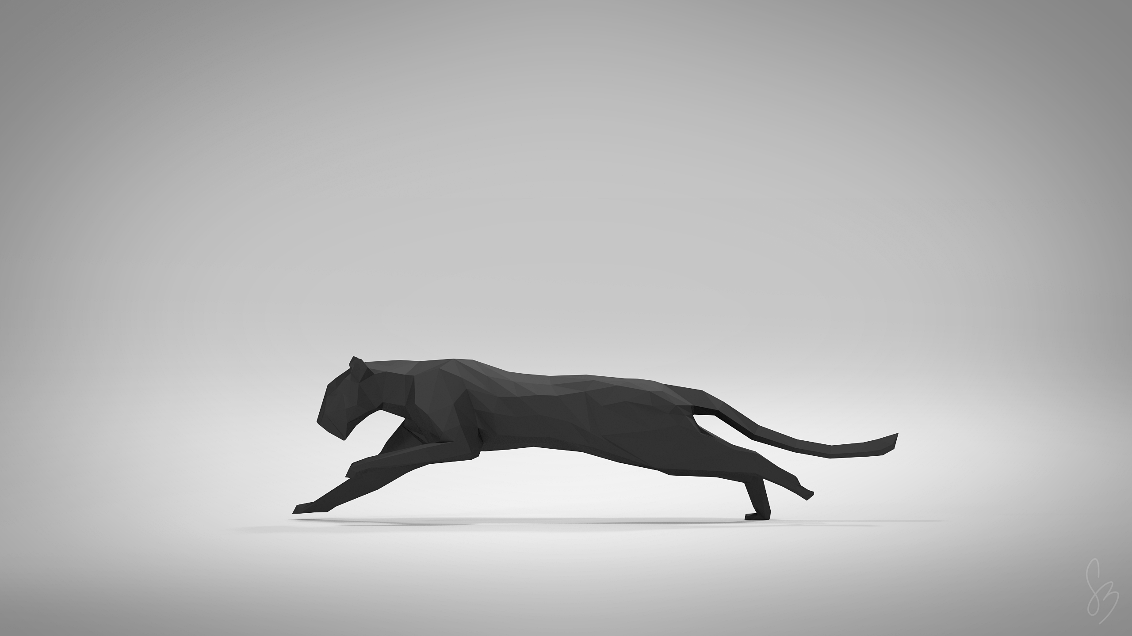
CBT – Kohn 2000
Jay interprets himself as a “loving husband and father” yet is the “no good thief and black sheep of the family”
☺ Behavioural chaining
-(e.g. wearing heavy jacket to hide items)
-Break this by holding hand of son, talking to manager
-Develop a conscience – “stealing raises prices for everyone”
☺ Covert Sensitisation
- Imagine thoughts related to emotion during scenario of stealing then linking consequences like having to call wife from jail

Slide 5
Pyromania: inability to resist urge to deliberately set fires in order to gain instant relief
● Deliberate initiation of fires on more than 1 occasion
● Tension/arousal before fire + interest with fire
● Relief when starting fires
● Starting fires not due to delusion/ revenge/ manic disorder
Psychoanalytic Approach:
□ Most pyromaniacs were males who had history of bed-wetting
□ Most have also been sexually abused, causing them to regress to earlier phallic stages
□ Fire symbolises sexual empowerment, pyromaniacs become sexually aroused by fire
Treatment: Free Association
- Randomly talk about childhood, therapist analyses conversation for event that may have triggered pyromaniac behaviour
Behavioural Approach:
□ SLT: imitating parents/friends who carelessly played with fire
□ (+) reinforcement for instant gratification and (-) reinforcement for removing anxiety
Treatment: CBT
- Aggression replacement training + anger management

Slide 6
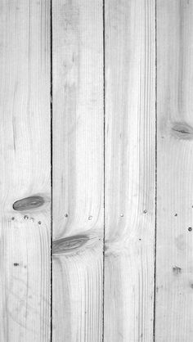
Biological
Initiation: Genetic vulnerability/ Chemical imbalance
Maintenance: DA reward pathway
Relapse: Psychological (pleasure cravings) and need to avoid physical symptoms
DA Reward Pathway:
Neuroadaptation:
-Raising/lowering optimum
Brain priming self to receive high dosage so develop tolerance
But neuroadaptation can’t last, so eventually optimum drops below normal causing alcoholics to drink just to feel normal - downregulation
● Ventral Tegmental Area (DA neurons triggered)
● Nucleus Accumbens (DA diffuse)
● PFC (Controls risky decision making)
Olds & Milner: electrode trigger pleasure areas – starve to death than run across electric board
Genes: DRD2 gene codes for DA receptors = A1 variant causes ↓ in receptors
So to get same amount of pleasure, must consume more
Evidence:
►Noble 1991: 2/3 dead alcoholics had variant, while 1/5 normal had variant
►Shuckit 1985:
Same odour + same tastes of 4-5 drinks (single blind)
Alcoholic mothers excluded (alcohol diffuse into placenta)
Sons of alcoholics swayed less, ↓ hormonal changes, performed better in hand-eye coordination
40% of sons of alcoholics showed decreased sensitivity while less than 10% did so

Slide 7
Initiation: Expectancy Theory
○ Initiation: heavy drinkers transmit (+) expectations of drinking (SLT) and intentionally use to escape
○ Maintenance + Relapse: more focus on unconscious expectations = loss of control
Self – Efficacy Theory (self fulfilling prophecy)
○ Initiation: Lack of control while engaging in behaviour
○ Maintenance + Relapse: Lack of discipline in quitting behaviour
Rational Choice Theory
○ Initiation: perceived short term benefit
○ Maintenance + Relapse: cost – benefit analysis (quitting isn’t worth weight gain)
Cognitive
Griffiths (1994)
Gamblers had irrational verbalisations (this fruity is not in a good mood) and irrational thinking (neat misses as near wins)
Illusion Of Control (skill)
● Gambler’s Fallacy (HHH-T-HHH)
●Sunk cost bias
● Flexible attributions (wins to skill, losses to bad luck)
● Fixation on absolute frequency (focus on wins rather than losses)
Known as heuristics

Slide 8
Behavioural
Initiation:
CC = associate “buzz” with gambling
SLT = vicarious reinforcement
Maintenance:
OC (fixed/variable/interval/ratio)
(+) pleasure
(-) anxiety
Relapse:
CC = associate familiar places with drinking
Self medication = remove withdrawal symptoms
Aversion Therapy
CC = re-associate addictive behaviour with unpleasant stimuli
Alcohol → pleasure/escape
Antabuse → feel ok
Antabuse + alcohol → violently ill
Token Economy (Liebsen et al. 1971)
Primary Reinforcement:
Cigarette + Pool games
Secondary Reinforcement:
Bank book – record earnings and expenditures
Fixed ratio for earning alcohol (drink moderately, then u gain money) and abstinence ( extra payment for subsequent days) – however not as effective

Slide 9
Rat Park 2010
Previous studies have shown given the choice, rats would prefer injecting themselves with drugs over food and water
Bruce Alexander aimed to study rats in solitary confinement
Prepared a mixture of morphine and sugar water, decreasing the doses of morphine each time
Caged rats consumed the solution earlier and at much larger volumes than Rat Park rats (once at max limit of sugar, then Rat Park rats readily consumed)
Kicking the Habit
► Purposely made rats addicted, by giving the drugged morphine water as their only choice
► Rat Park rats, when given the choice, chose water over the drugs punctuated choice days (9 days)
► Compared to isolated rats who actually increased their dosage

