Slide 1
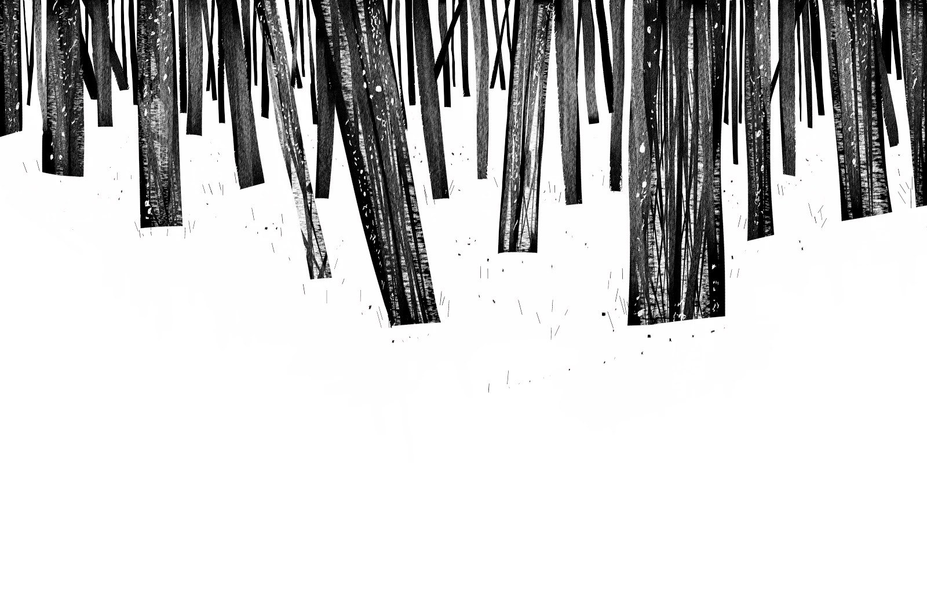
Phobias: persistent & irrational fear of specific object which leads to avoidance and interference in daily life

Slide 2
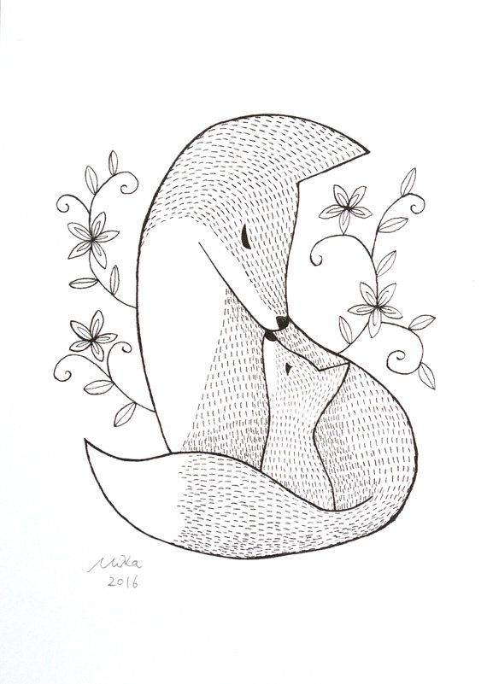
Agoraphobia
Eysenck (1997):
● Cognitive explanations focus on irrational thinking and faulty cognition
● Breathing in air which contained CO2 often provokes agoraphobics into experiencing panic attacks while normal controls were less susceptible
● Based on how they interpret somatic symptoms
● Biological view: CO2 act as competitive inhibitor to O2, therefore displacing it and reducing O2 in cerebral blood flow
● Sensitive amygdala so responds more intensely causing increased anxiety
● Ethics is questionable

Slide 3
Behavioural - CC
Mowrer (1947): 2 Process Theory
☼ C.C = creates phobia due to association of stimulus with fear
☼ O.C = maintenance of phobia
by + reinforcement (getting friends to come, convenience at home) and – reinforcement (takes away anxiety)
Watson & Raynor (1920)
☼ Little Albert - repeated pairing between rat and loud noise creating fear
☼ UCS (Bang) ► UCR (Fear)
☼ UCS (Bang) + Neutral (White Rat) ► UCR (Fear)
☼ CS (White Rat) ► CR (Fear)
☼ Generalised to all white and fluffy items (e.g. santa beard, rabbit, cotton wool)
Cook & Mineka (1984)
☼ Social Learning Theory
☼ Exposed lab-reared monkeys (no fear) to immunisation group (no fear) or latent inhibition group (fear) to snakes behind plexiglass
☼ Then both groups exposed to monkey with fear of snakes
= immunised group majority had no fear
= latent inhibition showed fear

Slide 4
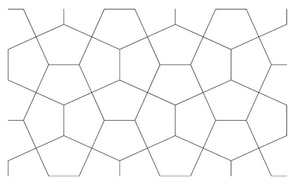
Behavioural Evaluation:
Application to real life: if we can trace back to original learning then we can relearn to associate the object with relaxation therefore causing extinction
Reductionist: fails to explain why similar experiences can cause some ppl to have phobias and others to be normal (diathesis stress model). Dinardo (1988) found that only 50% of dog phobics had been bitten by a dog
Evolution Evidence:
Seligman 1971 (BIOLOGICAL PREPARDENESS)
► We learn links more easily than others meaning less input is needed to associate a prepared stimulus to a non-prepared one
► Fear of harmful animals are an advantage because survival means genes can be passed on by natural selection
Empirical Evidence:
► Cook & Mineka 1990
Easier to condition monkeys to fear a toy snake over cuddly teddies
(reductionist: fur similar)
► Ohman 1996
-Found it easier to condition humans to fear snakes than flowers (reductionist: didn’t test with harmful plants e.g nightshade – hallucinations or poison ivy - rash

Slide 5
Psychoanalytic
Little Hans 1909
● Phobias are symbols for other fears, which are displaced onto innocuous objects
● Id expresses ideas and motives which are unacceptable which hinder the Superego’s morality principle.
● Ego mediates this conflict and tries to supress the Id’s ideas through defense mechanisms:
Reaction formation: opposite feelings
Sublimation: redirecting aggression to acceptable activity
Evaluation
□ Occam’s Razor theory: over-complicated, learning theory more simplistic
□ Deterministic: Being fixated is cause of phobia, no free – will to prevent fixation
□ Generalisation: makes phobia more comprehensible to society, by saying that this is human nature
(less stigma)

Slide 6
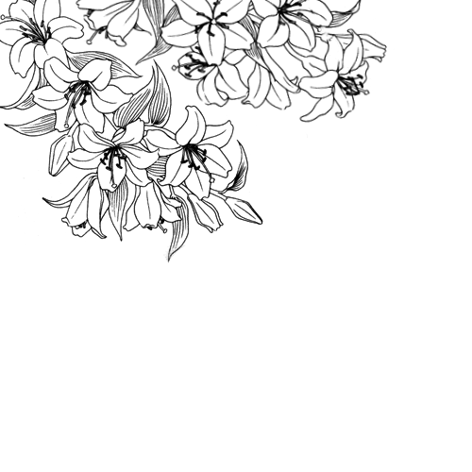
Biomedical
Genetic:
Ost (1992)
● Öst found that people with a phobia of blood injuries had 60% of first-degree relatives who also suffered from a specific blood-related phobia.
● 62% of injection phobics had 1st degree relatives
Brain Structure:
● Pine 1999: Social phobics had greater amygdala responses to fear than control group
● Hariri 2002: Right amygdala more responsive to angry fearful faces due to abnormality in 5HT receptors (↑ serotonin) = increased sensitivity

Slide 7
Cognitive
Dinardo 1988:
►50% of the group with no dog phobia also had memories of being bitten by dogs and yet had not developed any anxiety about seeing dogs in the future.
► Faulty cognition: activate pain inducing schema
Evaluation:
►Diathesis Stress Model: Trigger that lead to phobia (neurotransmitter, genetic, abuse)
► Reductionist: X not consider individual differences
►Scientific value questionable because not observable
► Free will – develop treatments for the malleable brain

Slide 8
Systematic Desensitisation
Wolpe 1958
☺ Counter Conditioning: Extinction of CR: Fear and association to new CR:(e.g. Wolpe used tensing and relaxing) or (Ventis 2001: laughing)
☺ Graduated Exposure: Patients construct stimulation hierarchy with ratings of fear. This is accompanied by biofeedback: pulse/breath measurements
☺ Participant Modelling: Incorporating SLT by watching someone else model relaxation technique
☺ In-vitro: Thinking & In-vivo: Being involved
Evaluation
● Application to real world: Rothbaum et al. (1995) created a virtual-reality helmet worn by the patient which displays a phobic situation which is controlled by the therapist. The scene might be one of driving a car over a high bridge. The pulse rate is monitored by the therapist. When the pulse rate gets too high, the scene is frozen in frame. The therapist then uses counter-conditioning to replace the fear with relaxation techniques.
● Individual differences: caters hierarchy to phobia, so higher success rate because can overcome fear for each situation (empowerment + lower relapse)
● Generalisability: Spider may drop from trees/mouse from pavement – not learned to face an unprepared stimuli
● Palliative not curative: SD doesn’t cure the cause of the phobia, only masks the symptoms

Slide 9
Flooding
Flooding is intense exposure to feared stimulus. This causes them to not be physiologically maintained. Fear response subsides and replaced with exhaustion. So relaxed state now experienced in presence of feared stimuli. Extinction of pairing with fear.
Effectiveness:
◊ Dependent on patient’s self will so ethical harm may occur to ensure success of treatment
◊ Cost-effective + less time-consuming
Wolpe 1973
● Girl phobia with cars so drove her around until she calmed down
Stampfl 1967
● In-vitro – bombarded patients with fear description for 6-9 hours

Slide 10
Applied Tension
Ost 1989
● Treats phobia of blood and injections
● Fainting decreases bp, hr, cbf so AT increases bp,hr,cbf
● Recognise early symptoms e.g nausea and dizziness
● Exposure to phobia watched video of surgery
● Improvement in fainters where they took 5-10 mins to recover instead of the average 3 - 4 hours
Evaluation:
◊ Coping strategy:
Prevents relapse
Free will to empower so confidence to prevent fainting
◊ Post treatment follow up showed improvement
◊ Might be too reductionist, only deals with fainting and not anxiety
◊ Palliative not curative

Slide 11
CBT
Ost & Westling (1995)
► Produce alternative cognition – change panic to thinking logically
► 74% success rate and 89% at follow – up
Juster + Heimberg (1994)
► Treatment of social phobia
► Identification, classification, disputation,development
Improves rate of relapse because it gives skills for coping unlike drugs
Reductionist, because environment factors can be unchangeable like lifestyle

